Slide 1
Bullet Graph Hands On
Data Visualization
John F. Tripp

Slide 2
Bullet Graphs are Information Dense
Bullet Graphs allow you to turn numbers into metrics.
  Allow you to show whether a number is “good” or “bad”
  ALSO shows “how good” and “how bad”
  Designed to replace dials on dashboards
They are an optimal graph for dashboards.

Slide 3
Bullet Graph
Three components
  Bars showing level of variable
  Vertical lines showing “target” of comparison
  60%, 80%, 100% (of TARGET) shading.

Slide 4
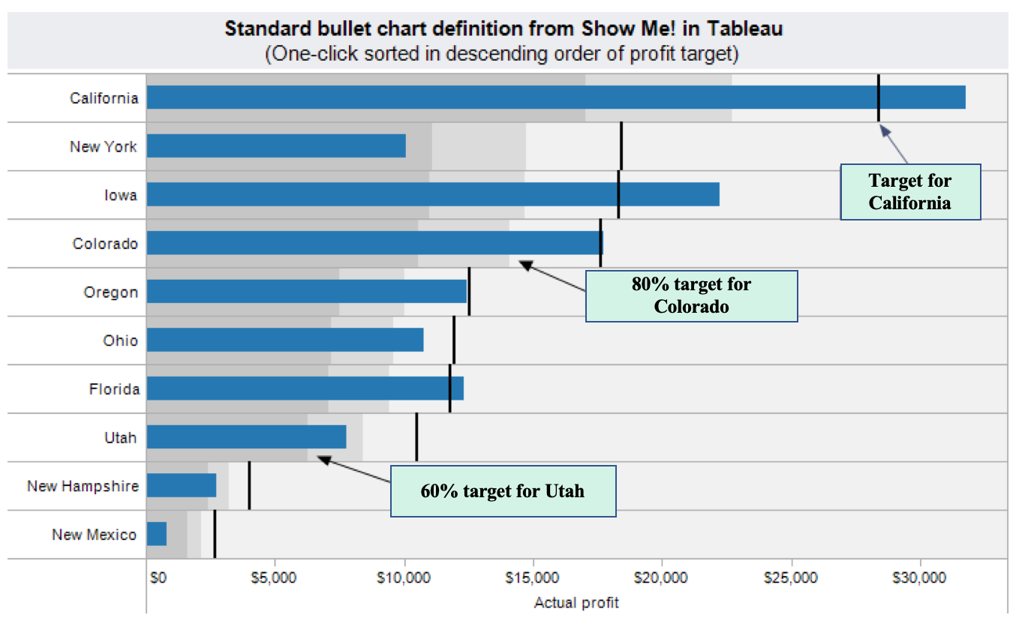
Bullet Graph

Slide 5
Bullet Graph Hands On
Open the BulletGraphHandsOn – Start.twbx file

Slide 6
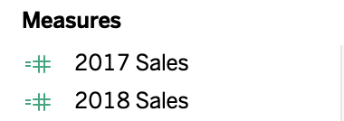
Bullet Graph - Tableau
Tableau will create a Bullet Graph using Show Me.
But first, you need the performance and target data.
This workbook has these fields already created.

Slide 7
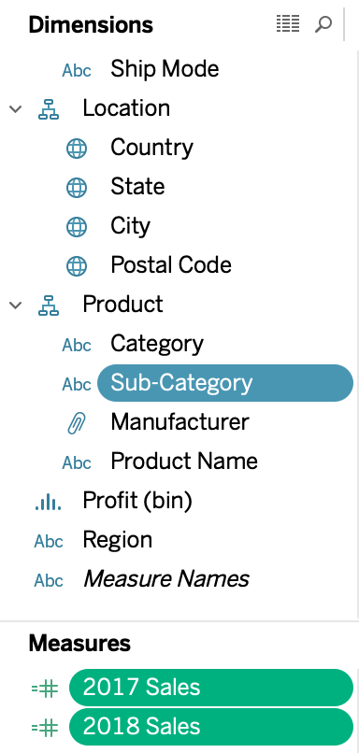
Bullet Graph - Tableau
Multiple-Click the 2018 Sales, 2017 Sales, and Sub-Category
  To multiple click, hold down CTRL on Windows, or Command(⌘) on Mac.

Slide 8
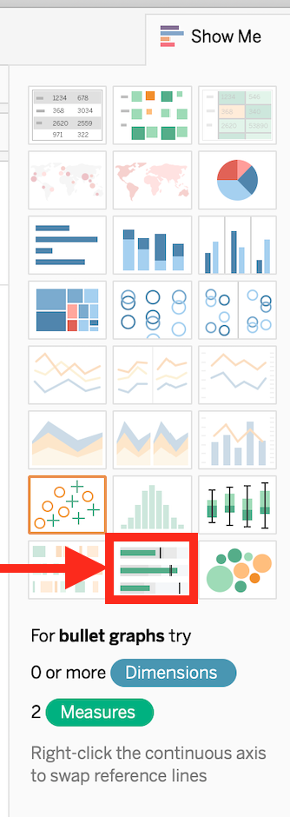
Bullet Graph - Tableau
Click on Show Me, and then click on Bullet Graph

Slide 9
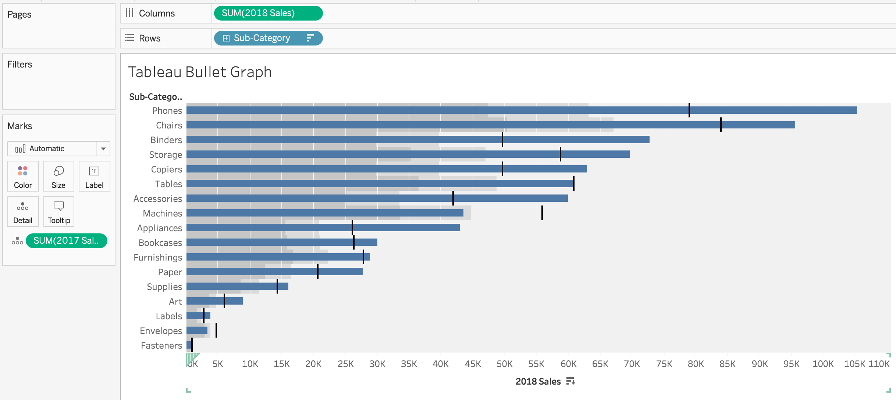
Bullet Graph - Tableau
Sort, the chart, and it will look like this.

Slide 10
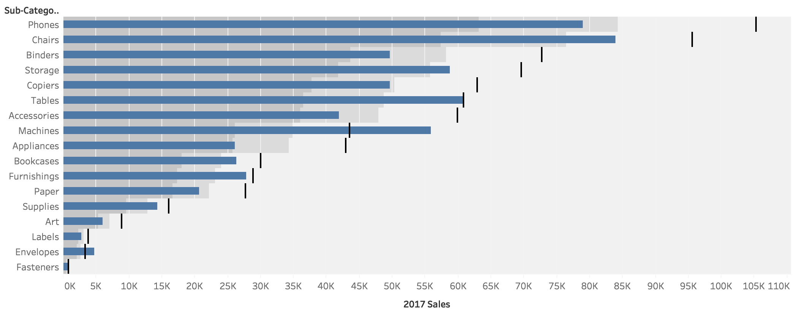
Bullet Graph - Tableau
NOTE: Sometimes Tableau misidentifies the target and goal fields.

Slide 11
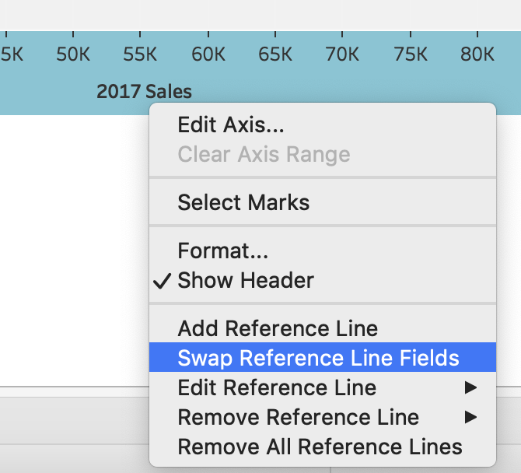
Bullet Graph - Tableau
To correct this, right click on the x-axis, and choose “Swap Reference Line Fields.”

Slide 12
Bullet Graphs – What’s going on?
Three components

Slide 13
Bullet Graph - Manual
Three components
  Bars showing level of variable (Standard Bar Chart)
  Vertical lines showing “target” of comparison (Reference Line)
  60%, 80%, 100% (of TARGET) shading. (Reference Distribution)

Slide 14
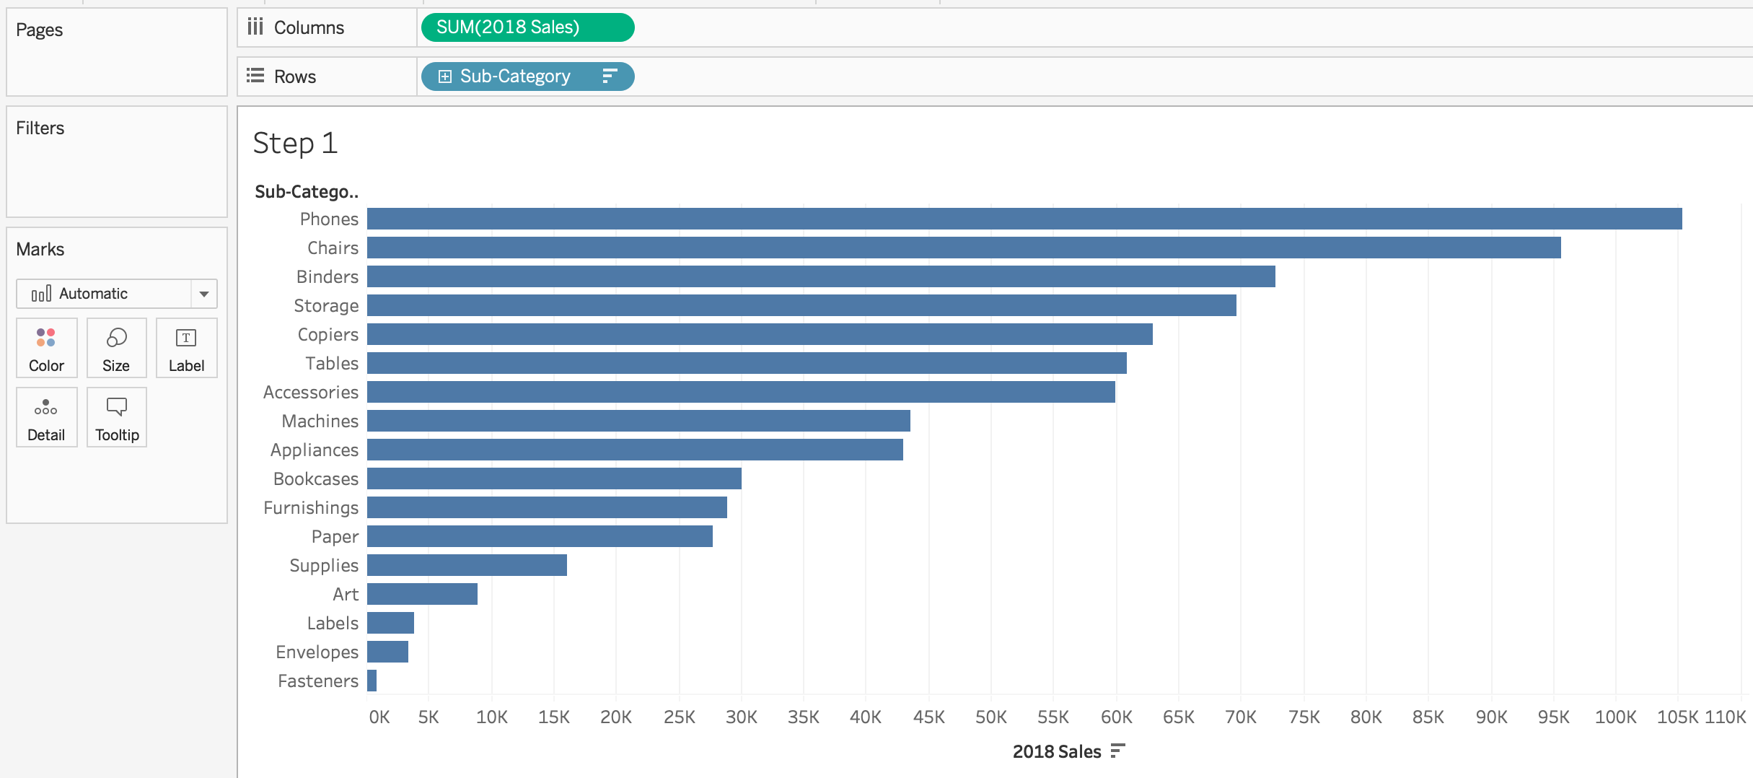
Step One - Make the Bar Chart
Place 2018 Sales in columns, Sub-Category in rows.
Sort chart

Slide 15
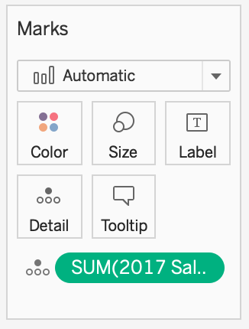
Step Two – Get the Reference Information
Place 2017 in the details marks card
This is necessary in order to use it for reference lines

Slide 16
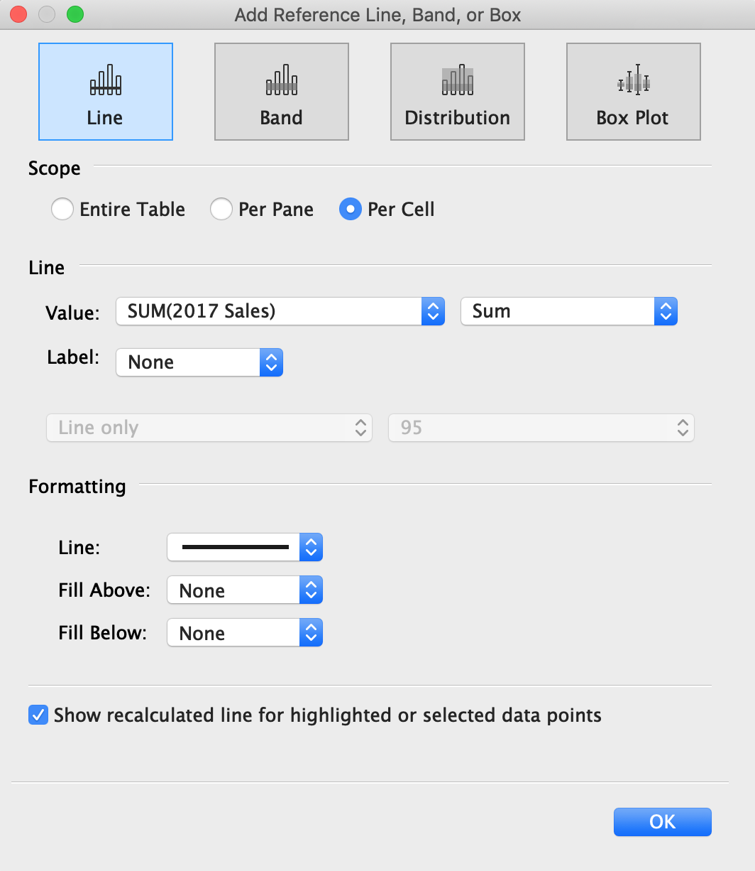
Step Three – Make the Reference Lines
Right-click on the x-axis, and choose “Add Reference Line”
Choose “Line”
Scope: Per Cell
Line/Value: SUM(2017 Sales)
Label: None
Make line format darker and thicker

Slide 17
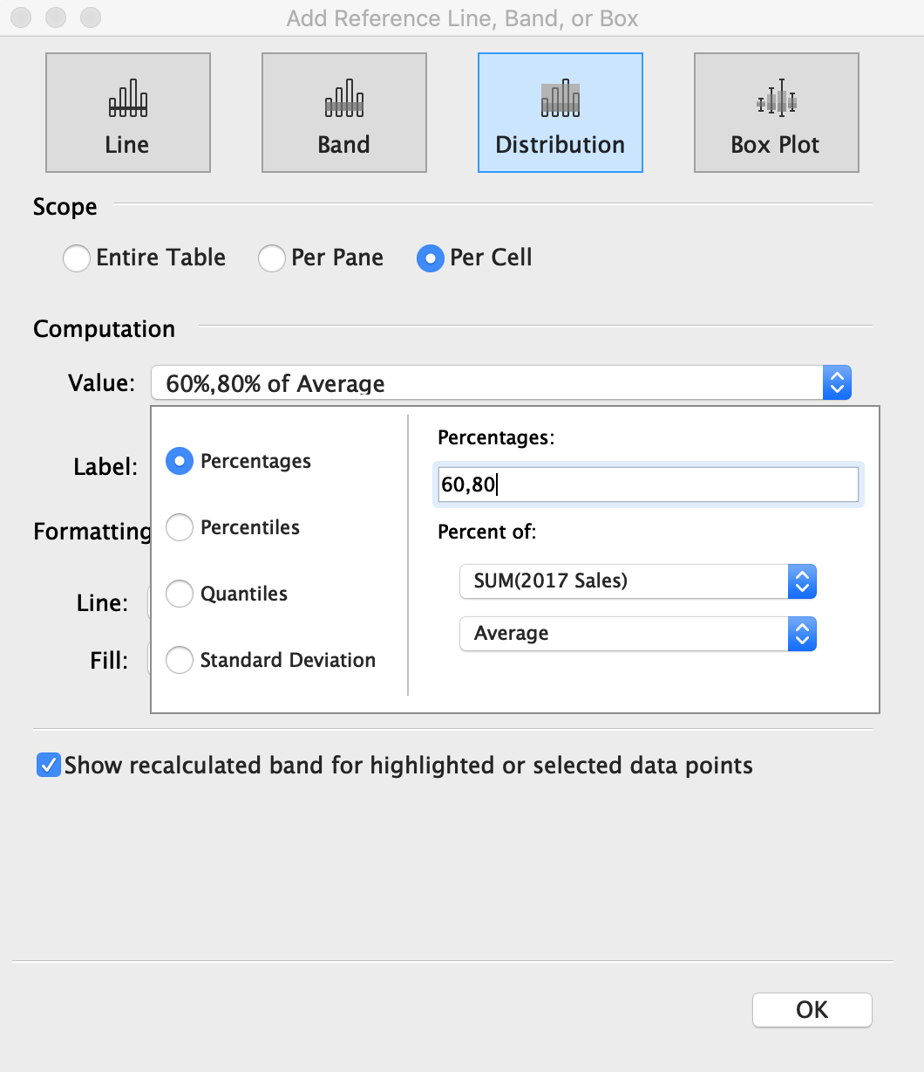
Step Four – Make the Distribution
Right-click on the x-axis, and choose “Add Reference Line”
Choose “Distribution”
Value: 60%, 80% of Average
Click the drop down on Value
Choose Percent of SUM(2017 Sales)

Slide 18
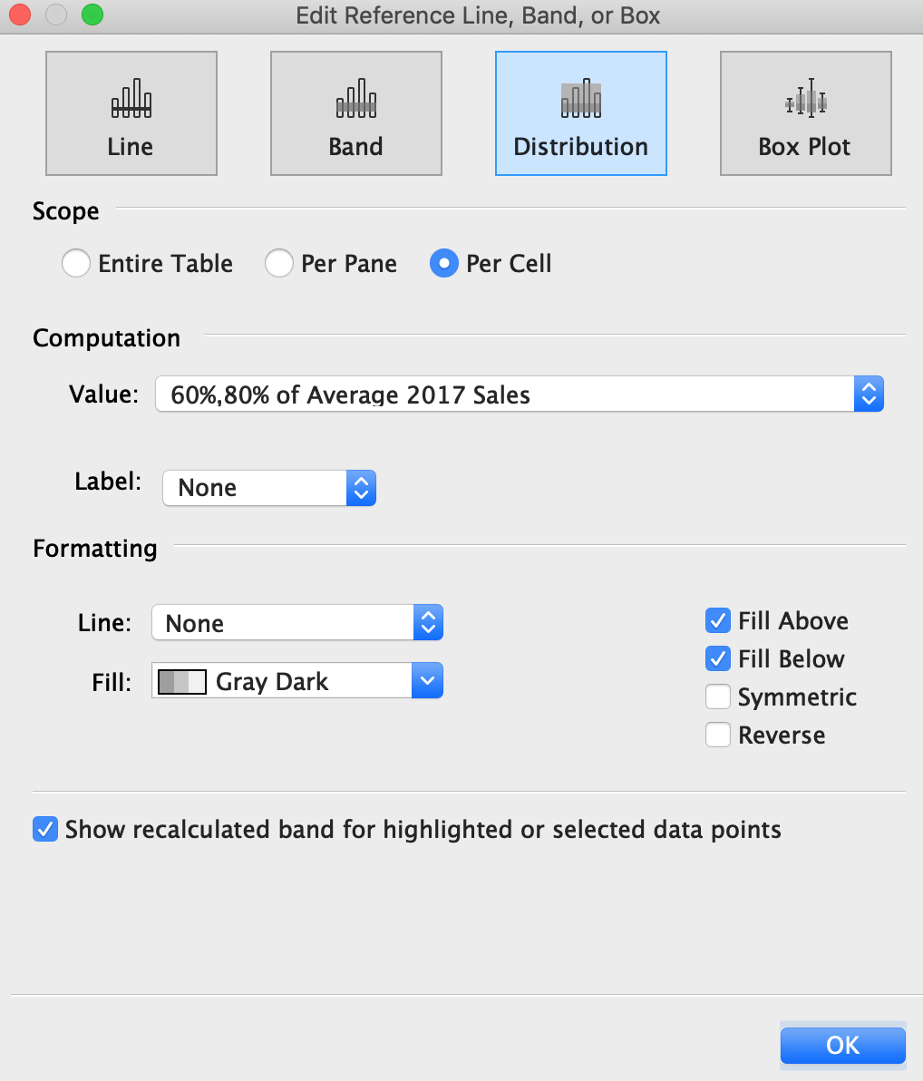
Step Four – Make the Distribution
Change Label to None
Formatting:
  Line: None
  Fill: Gray or Gray Dark
  Fill Above and Fill Below
Click OK

Slide 19
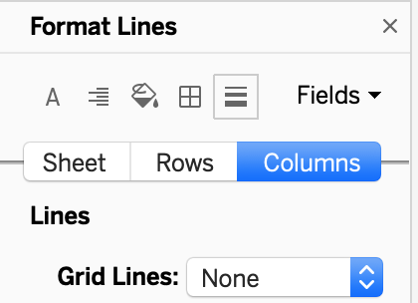
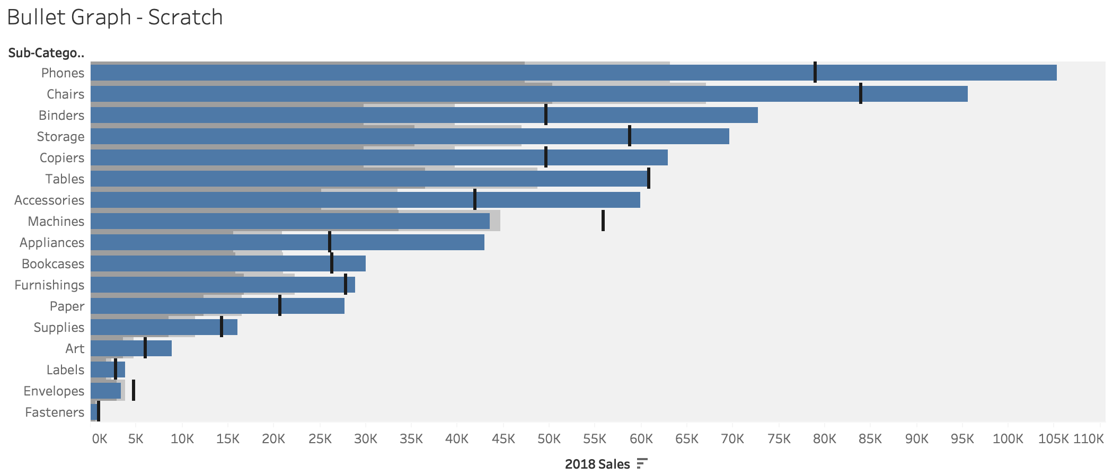
Step Five – Clean Up
Remove all column dividers (format menu)

